Slide 1
Neural Networks: Physics Applications

Slide 2
Outline
Why are NN’s so powerful?
What

Slide 3
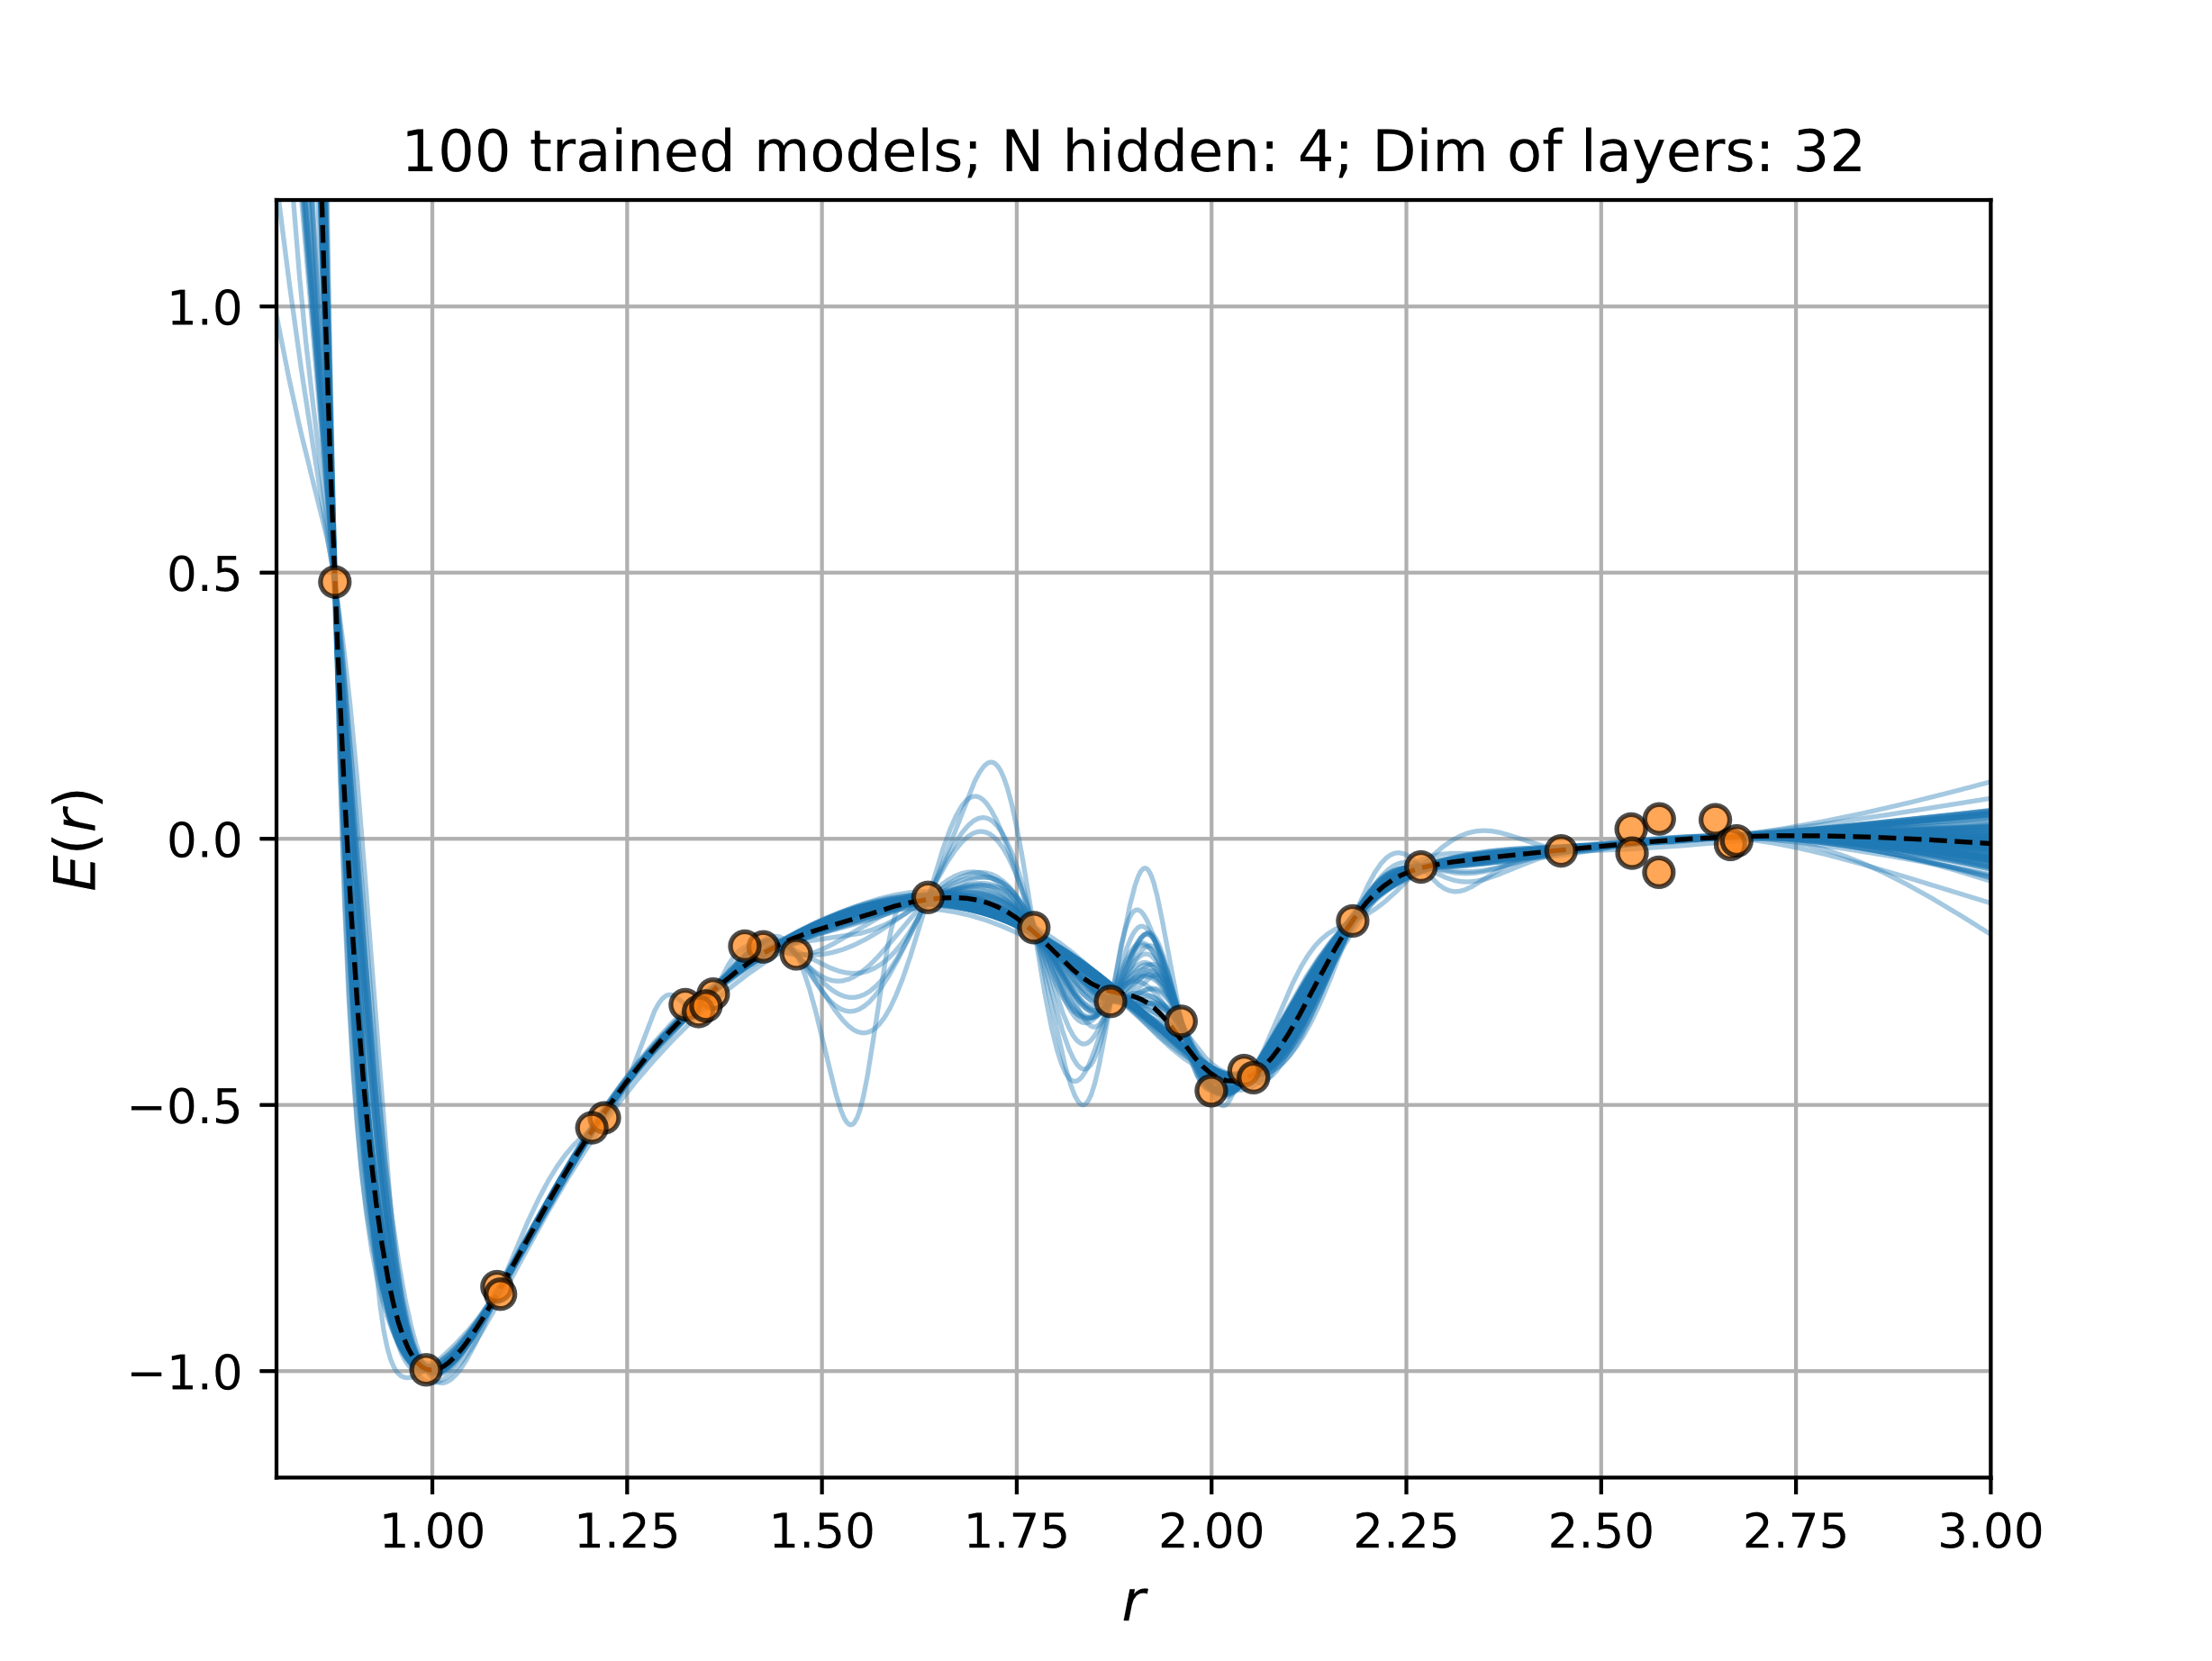
Why are they so powerful?
Universal function approximator
What about uncertainties?
What about the physics?
Particle physics
Massive datasets
Expensive numerical calculations
Extrapolation

Slide 4
Example: Classification using NN’

Slide 5
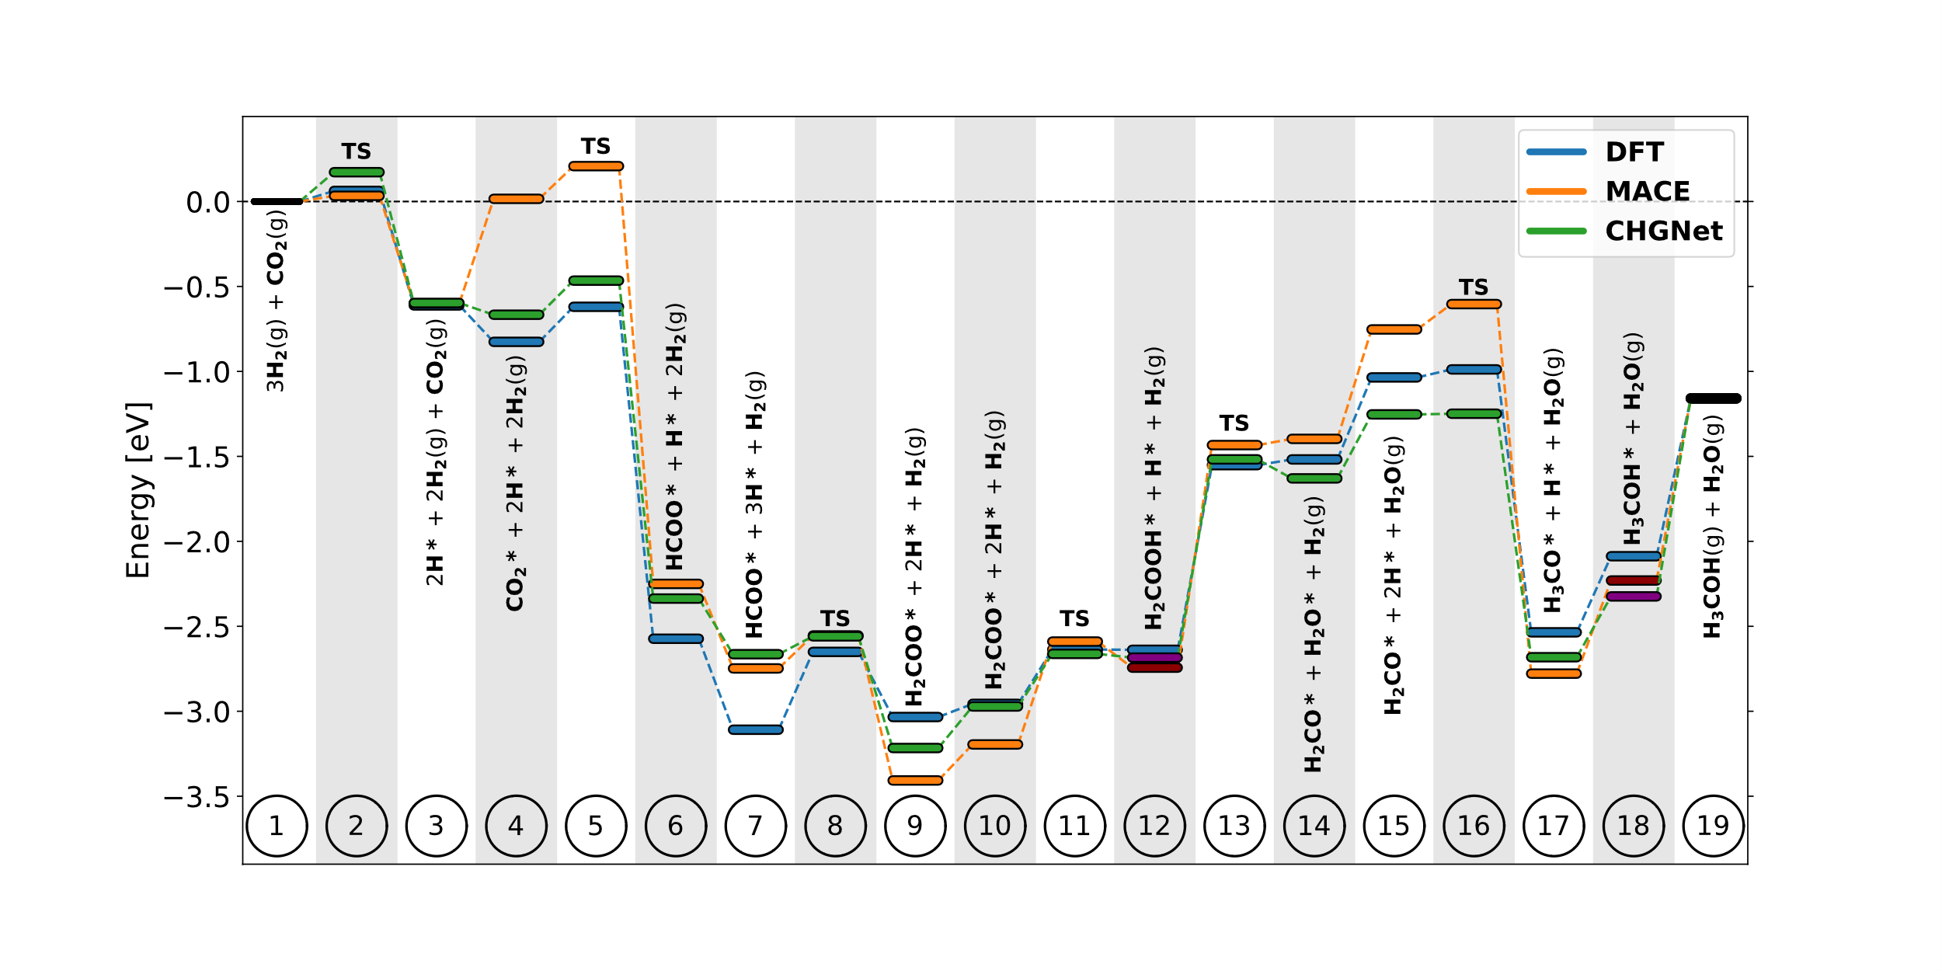
Is this fair?

